Slide 1

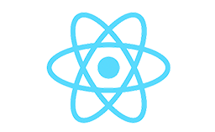
Installing React JS & Creating First React App
PART-4
REACT
Presenter: mohammad adil

Slide 2
Installing React JS
1st Step:
Install VS Code & Extensions
2nd Step:
Install Node JS & NPM.
After installing Node JS & NPM check the version of Node JS & NPM.
node -v
npm -v

Slide 3
Installing React From VS Code Terminal
npm install –g create-react-app
Check the version of “create-react-app” by using
create-react-app –version
Creating React App By Using
create-react-app “App_Name”

Slide 4
Starting React App On Server
Npm start
It serves our react app on 3000 port number of localhost.

